Slide 1
People Horses Culture
Morphettville, South Australia
24 May 2018
NSW Department of Primary Industries
Horse identification and traceability survey results
Lisa Burrows
Leader Traceability
NSW Department of Primary Industries
lisa.burrows@dpi.nsw.gov.au

Slide 2
Origins of horse survey
Tragic horse accident involving death of a girl at Dubbo jillaroo school in 2009
Parents sought change – wanted lifetime traceability of horses and safety for horse riders/users in workplaces
Resulted in 2016 ‘Code of Practice for managing risks when new/inexperienced riders/handlers interact with horses in the workplace’ (SafeWork NSW)
Strong support by NSW Police for horse identification and some traceability – lost/stolen horses; misrepresentation
Realised that life time traceability – like NLIS for cattle – is not practical for horse industry at this stage
Animal Health Committee asked DPI in April 2016 to consult further – hence the 2017 DPI Horse ID and traceability survey

Slide 3
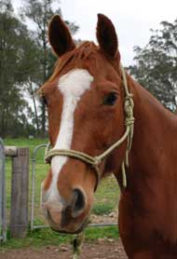
Feedback sought on horse identification
NSW DPI survey launched 4 September 2017 and closed on 31 December.
Horse owners asked to have their say about the possible introduction of mandatory identification for all horses in NSW.
NSW DPI seeking feedback via a short online survey to gauge interest and support for a simple NSW horse identification scheme.
2243 responses received.

Slide 4
Survey Q1 to Q6
If you are part of an association or other horse group:
What is the name of your club?
How many members and horses are there?
Are the members’ horses microchipped or otherwise identified?
Are their owner and location details recorded in a database?
What method is used to identify horses if microchips aren’t used?

Slide 5
Responses
1. 50% of respondents were member of a horse association or club, e.g. ACA, ABCRA, AQHA, ASH
2. 48% responded: members of these clubs and their horses numbered from 10 to 100s or 1000s
3. 49% responded: of those 65% of the members’ horses were microchipped or identified in some other way
4. 48% responded: 71% of those had their horses’ owner and location already recorded in a database
5. 39% responded that their horses were identified by other method: brands, breed registration, reg papers, DNA, EA, freeze brands, markings, PICs, photos,

Slide 6
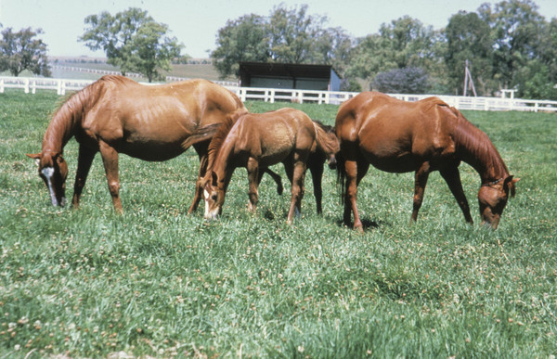
Survey Q6
As a horse owner how many horses do you own or have under your management?
93% response.
Number of horses under survey respondents’ management ranged from one, to 30, 300 to >10,000

Slide 7
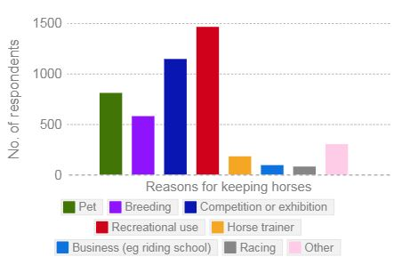
Survey Q7
93% response to…Why do you own or have a horse or horses?

Slide 8
Response Q8
Would there be benefits in identifying all horses in NSW with a microchip and recording this information in one central database?
- 93% response (2078 responses)
- Yes 76%
- No 24%

Slide 9
Response Q9
Do you think registering all horses’ owner and contact details, and horse identification details, in a central database would be useful to you and your club?
- 90% response
- Yes 66%
- No 34%

Slide 10
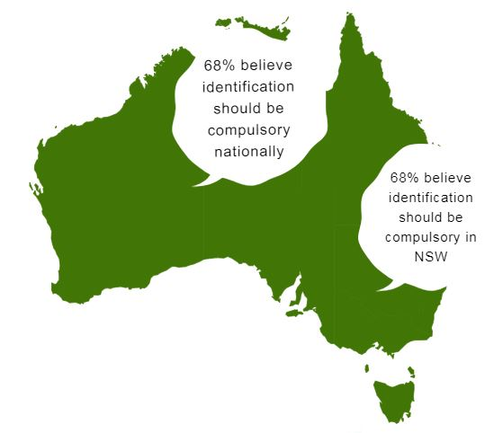
Survey Q10 and Q11
Should it be compulsory for all horses in NSW to be microchipped or identified in some other way? (92% responded)
- Yes 68%
Should it be compulsory for all horses, nationally, to be microchipped or identified in some other way? (92% responded)
- Yes 68%

Slide 11
Survey Q12 , Q13 and Q14
Would a NSW or national registration database be more suitable?
81% response
NSW 9%
National database 91%
Should the database be updated by the horse’s owner: (91% response)
- every time it changes its primary residence? Yes 70%
- every time its ownership changes? Yes 68%

Slide 12
Survey Q15 and Q 16
Would the cost of identifying your horse plus a small database registration fee be an impediment to the roll out of a horse identification scheme?
93% response
Yes 69% / No 31%
Would an online event register be a suitable alternative to a national registration database?
91% response
Yes 32% / No 68%

Slide 13
Q17 general survey comments
Great idea to keep track of horses
Should be part of responsible horse ownership
Central database long overdue
Support compulsory chipping and transfer of ownership
National scheme preferable but ok to start with states
Can see many benefits
Make it happen
Good luck!
Keep it simple
Push it for disease outbreaks – EI!
What about passport scheme?
Most competition horses are chipped
Government money grab
Waste of time and money
How do you register all the brumbies?
How would it be policed?
Cost is a major concern
What about horses that never leave home?
Already registered – don’t want to pay twice
Add it onto NLIS and PICs – don’t create another system
Hard to enforce
I’m not computer literate
Govt has no right to dictate what I have to do
Information overload
Horse owners are an interesting bunch to deal with

Slide 14
Conclusions and next steps
97% of responses were from individuals; not on behalf of an organisation
Pleased with number of responses (2243)
Survey questions weren’t perfect and DPI would likely pose some different questions if doing another survey
Benefits of horse identification from biosecurity perspective:
                - traceability / reduced biosecurity risk
                - better animal welfare
                - less crime and theft
                - better breeding controls
Paper on Horse Identification and Traceability will be submitted soon to Animal Health Committee Out Of Session. All states’ Chief Veterinary Officers are members of AHC. NSW DPI next actions will be guided by the AHC response.
DPI will continue to more detailed consultation with horse groups

Slide 15
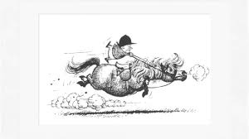
Any questions?

