Slide 1
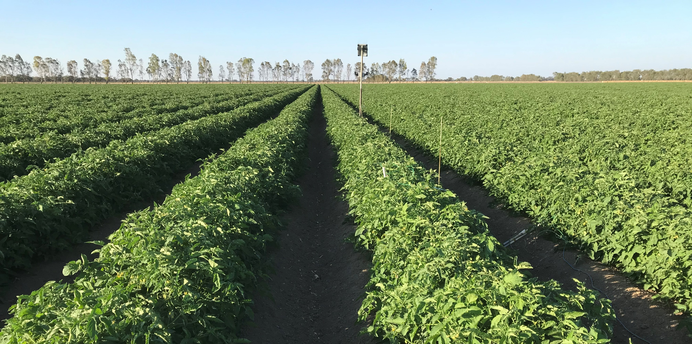



Water: the key factor limiting the yield of Australian drip irrigated processing tomatoes
Sam North, Alex Schultz, Don Griffin

Slide 2
Project aims
“The industry needs higher productivity to remain viable” = 200 t/ha target
Soil constraints identified as a major impediment to achieving higher yields
BUT
What is the problem?
Project goal = gain a better understand key factors limiting yields
Three questions based on the hypothesis that water is the key driver of yield:
Are lower yields associated with smaller canopies?
Are smaller canopies warmer canopies
Are canopies warmer because of soil water deficit &/or waterlogging
Link plant response (yield) to a condition (water stress)
Notes:
Effect – condition – cause
Example of waterlogging and salinization
dead plants – high watertables – more efficient irrigation
IF smaller canopies = lower yields AND smaller canopies = water stressed THEN problem = water
IF NOT then look elsewhere – disease, ?????

Slide 3
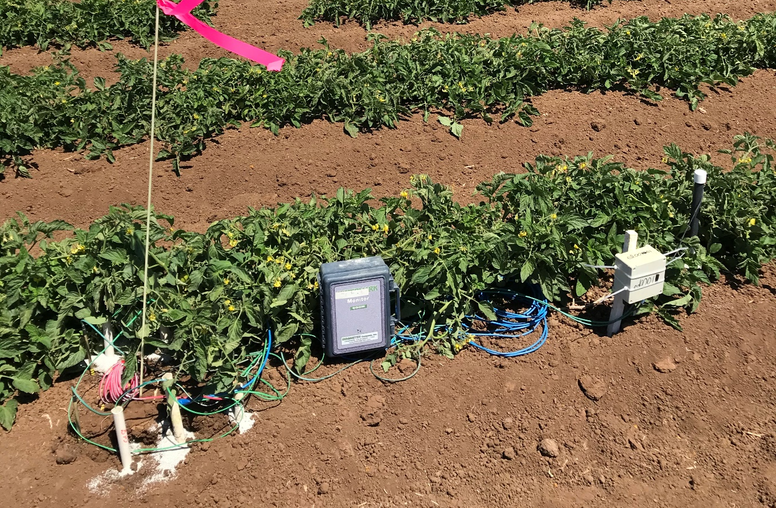
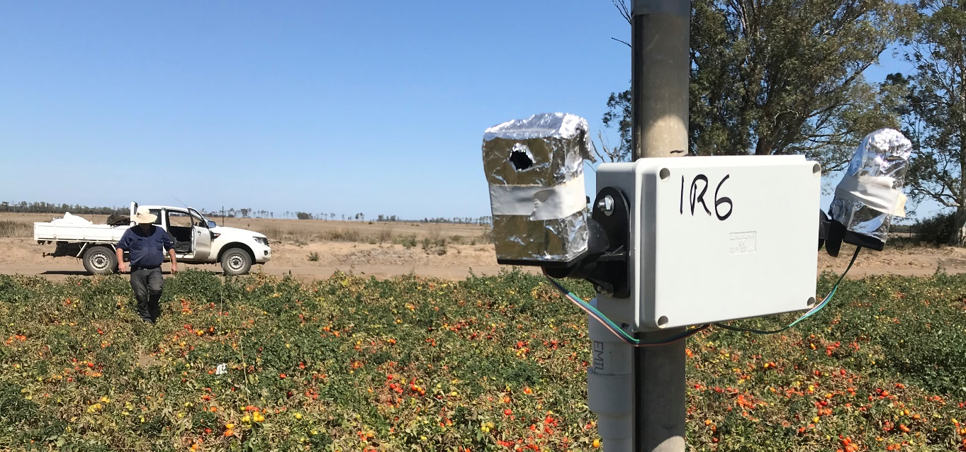
Project work – 2019-2020 season
9 monitor sites in commercial field tomato crops
  4 on texture contrast soils (chromosol)
  5 on uniform clays (vertosols)
  All on sub-surface drip – range of plant dates
Plant data
  Canopy growth - NDVI from IrriSAT™
  Yield & yield components (% moist) - 3 quadrats; 2 m row
Soil and plant sensor data
  Watermark™ (ψ_{m}) - mid/shoulder at 10, 20 and 35 cm (3 reps)
  IR temperature sensors (T_{c}) – 2 sensors, 5º FOV, 1.8 m² target
Soil data – Dec & May
  Chemistry – pH, EC, NPKS, exchangeable cations
  Physics - bulk density, penetration resistance, K_{sat}
Notes:
Veg growth to 530 ºCd
Terminal fruit cluster at 800 ºCd
Early fruit maturity at 1200 ºCd

Slide 4
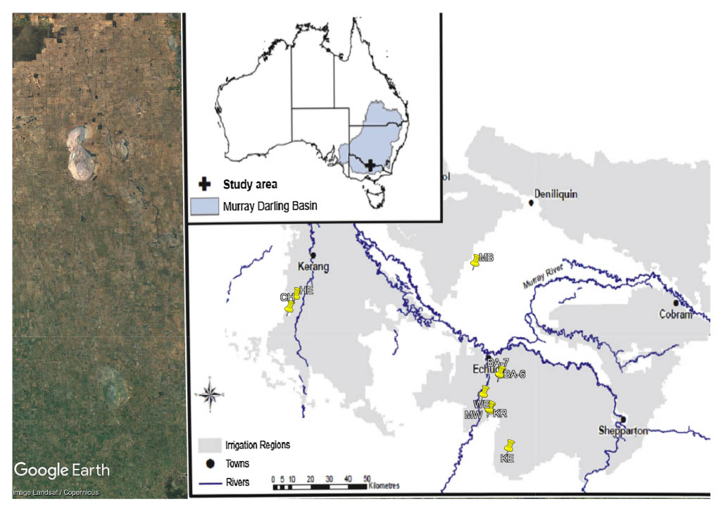
Site selection – an observational trial
Site | Soil type | Clay (%) | Emitter rate (L/hr) | Row Space (m) | Tape age (years) | Preceding crops | Variety Mix
BA-6 | chromosols | 29 | 1.05 | 1.52 | new | tomato – corn - corn | UG
BA-7 |  | 38 |  |  | 9
KR |  | 19 | 1.60 |  | 8
MB |  | 26 | 1.05 |  | 5 | tomato – faba bean – fallow | Heinz
WE | vertosols | 46 | 1.05 | 1.52 | n/r | 20 yrs since tomato | Heinz
KE |  | 45 | 1.60 |  | 4 | tomato – chickpea – fallow | Heinz
MW |  | 40 |  |  | 3 | tomato – tomato | Heinz
HE |  | 46 |  | 1.68 | 2 | re-laser – tomato | Heinz
CH |  | 42 |  |  | 9 | tomato – fallow | Heinz

Slide 5
Water use and yields
Site | Rain | Irrigation | Crop Water Use | Deep Drainage | Leaching Fraction | N | Yield
 | mm | mm | mm | mm | % | kg ha⁻¹ | t ha-¹
BA-6 | 138 | 625 | 451 | 312 | 41 | 349 | 103
BA-7 | 152 | 655 | 462 | 345 | 43 | 349 | 105
KR | 156 | 840 | 478 | 518 | 52 | 333 | 116
MB | 61 | 800 | 568 | 293 | 34 | 375 | 148
WE | 185 | n/r | 656 | -- | -- | n/r | 160
KE | 118 | 500 | 441 | 177 | 29 | 319 | 123
MW | 156 | 665 | 509 | 312 | 38 | 333 | 137
HE | 81 | 610 | 612 | 79 | 11 | 313 | 145
CH | 86 | 700 | 610 | 176 | 22 | n/r | 182

Slide 6
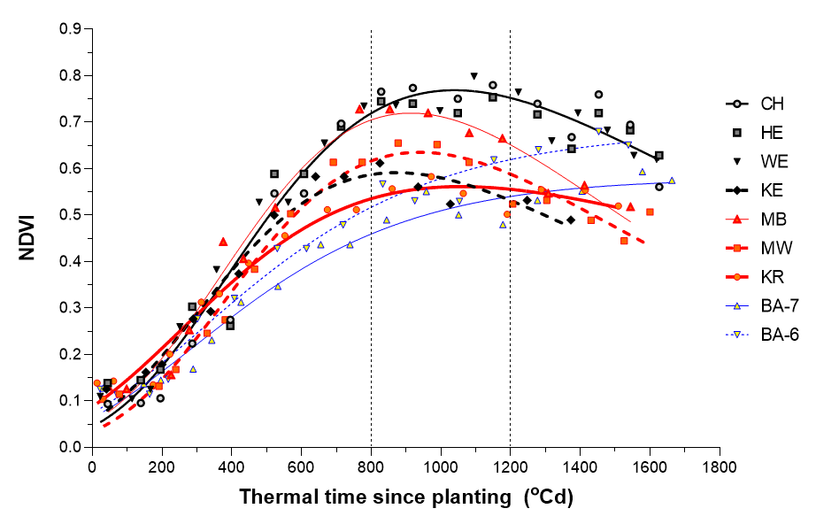
Yield is correlated to max. canopy size
Notes:
Average NDVI between 800 1200 GDD is well correlated with yield when corrected for fruit moisture and fruit size.
Yield is determined primarily by number of fruiting sites per ha, which depends on canopy size.

Slide 7
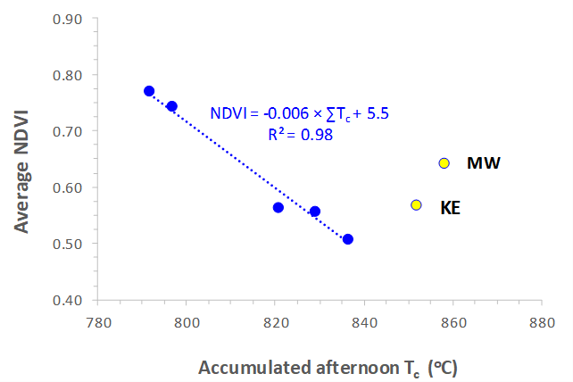
Canopy temperature vs size
BUT is T_{c} due to water or disease?
(missing data at 2 sites)
Notes:
Two sites (WE & MB) could not be included because of temperature logger failure meant missing data during period 800 to 1200 GDD

Slide 8
Water logging + water stress = the major factor
root disease
(waterlogging)
foliar
disease
Notes:
Stress days during January
STRESS is accumulated sum of hours that soil matric potential > -6 kPa = waterlogged OR <-50 ka = drought stressed
Importance of waterlogging at KE – I suspect this is what drove disease (cause – condition – effect)
All bar one crop could have been better watered

Slide 9
The effect of soil type – wetting pattern in beds

Slide 10
Soil characteristics + irrigation = water availability
over irrigated
hillside
watertable

Slide 11
Summing up
Soil condition was linked to a plant response
  Greater waterlogging or water stress = lower yield (R² = 0.78)
T_{c} NOT a good stress indicator in tomato – water or disease
Soil water potential IS a good indicator of water stress
Lighter textured soils (chromosols) are difficult to manage
  They don’t wet laterally & up from SSD, unlike vertosols – capillary wetting
  Steep gradients in beds – waterlogged AND dry soil
  Poor water distribution in beds – the cause of lower yields
  Implications for irrigation & fertiliser management (Stork et al., 2003, AJSR)
Reduce DD to improve water & fertiliser efficiency (200 t/ha ??)
  Leaching fraction – 20% vertosols; 40% chromosols
Recommendations
  Adopt soil sensor based irrigation scheduling
  Investigate better tape design (e.g. shallow drip lines, closer emitters)
Notes:
Stu McColl at presentation on 30 July
One block with a range of soil types – same inputs, same irrigation system and management
70 t/ha from red soils and 130 t/ha from grey soils

Slide 12
Thank you
Questions ?

