Slide 1

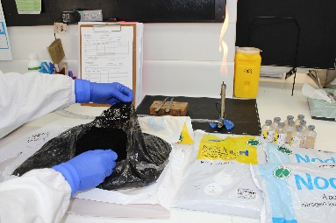
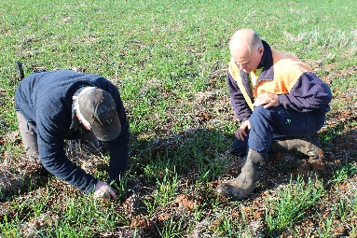
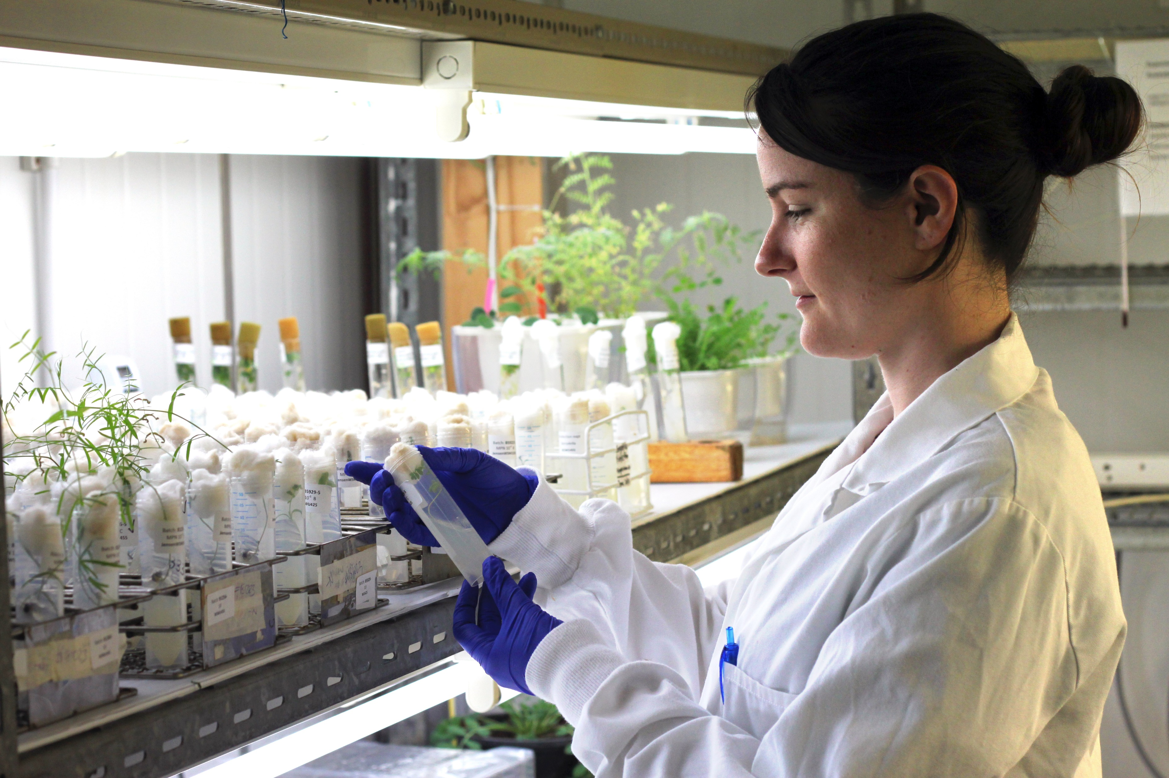
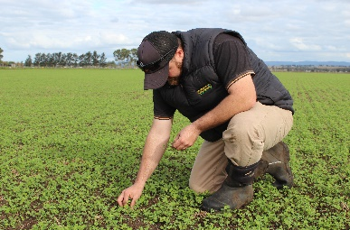
®
Australian Inoculants Research Group
Quality Assured Australian Biological Inoculants

Slide 2

Providing Quality Assurance Confidence
AIRG test mother culture rhizobia for inoculant products
®
Why is this important?
The symbiotic relationship between rhizobia and legumes is fundamental to nodule formation and highly specific to the rhizobial strain and legume species/ cultivar.
Rhizobia can lose their ability to nodulate a host or fix nitrogen effectively with time.
Genetic drift can reduce effectiveness
How do AIRG provide QA?
Maintenance of the Rhizobial Inoculant Strains Table so that primary producers can easily match the right inoculant for each legume group they plan to sow.
Annual testing of existing mother cultures and rigorous laboratory and field testing of new strains.
The selection of rhizobial strains is evaluated upon the following:
Effectiveness in nodulation, N fixation and their legume host range;
Genetic stability the strain must maintain its nodulation and N fixation performance during culture, manufacture and application;
Potential for scale-up production as commercial inoculants; and
Ability to survive during inoculant application- strains need to survive well on seed and in soil after sowing.
All work is conducted under the National Code of Practice and Quality Trademark for Legume Microbial Inoculant Products used in Australian Crops and Pastures
www.dpi.gov.au
© State of New South Wales through Department of Planning, Industry & Environment 2020. The information contained in this publication is based on knowledge and understanding at the time of writing (September 2020). However, because of advances in knowledge, users are reminded of the need to ensure that the information upon which they rely is up to date and to check the currency of the information with the appropriate officer of the Department of Planning, Industry & Environment or the user’s independent adviser.

Slide 3

Independent Green Tick QA Program
AIRG undertakes independent batch testing of manufactured rhizobial products
Green Tick inoculants have labelling standards that display:
The legume/s for which the inoculant should be used.
Batch number.
A product shelf-life or expiry date.
Conditions under which the product must be stored.
Guaranteed number of rhizobia per unit of product at the point of sale; and
Method of application to seed or soil of the product.
®
Why is this important?
A Green Tick on product packaging means the inoculant is optimised for success.
The product needs to contain the correct and viable strain of rhizobia for the legume you intend to grow.
Nodulation is a numbers game- live rhizobia of at least 1 billion/gram are needed in each, and every, manufactured product.
The product needs to be free from contaminants; and
The product needs to work on the intended host legume post manufacture.
How do AIRG provide QA?
They conduct independent testing in their laboratories for manufacturers that are signatories to the National Code.
Only when a batch is proven to meet National Code standards is it then given the Green Tick and can be dispatched.
Transparent labelling, underpinned by independent testing, provides a solid foundation for nodulation success and more profitable production outcomes.
www.dpi.gov.au
© State of New South Wales through Department of Planning, Industry & Environment 2020. The information contained in this publication is based on knowledge and understanding at the time of writing (September 2020). However, because of advances in knowledge, users are reminded of the need to ensure that the information upon which they rely is up to date and to check the currency of the information with the appropriate officer of the Department of Planning, Industry & Environment or the user’s independent adviser.

Slide 4

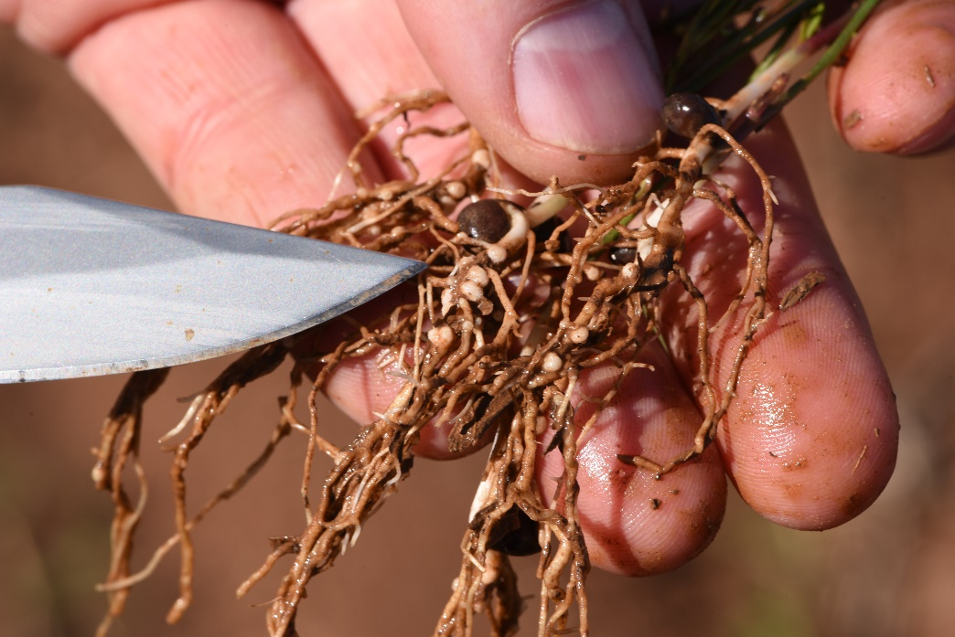
Research and development
AIRG partners with R&D organisations and Australian manufacturers of inoculants
®
Why is this important?
Reduces lag-time between research and commercial scale production of advanced strains and products.
Ensures strain evaluation remains relevant to evolving legume improvement programs.
Timely independent verification of manufacturer in-house laboratory testing.
How do AIRG provide QA?
Conduct testing for elite rhizobial strains for major groups
Selected strains undergo 10 field trials over a minimum of 2 seasons with minimum treatments of new V current V not inoculated.
Coordinate independent assessment and voting process under the National Code prior to adoption.
www.dpi.gov.au
© State of New South Wales through Department of Planning, Industry & Environment 2020. The information contained in this publication is based on knowledge and understanding at the time of writing (September 2020). However, because of advances in knowledge, users are reminded of the need to ensure that the information upon which they rely is up to date and to check the currency of the information with the appropriate officer of the Department of Planning, Industry & Environment or the user’s independent adviser.

Slide 5
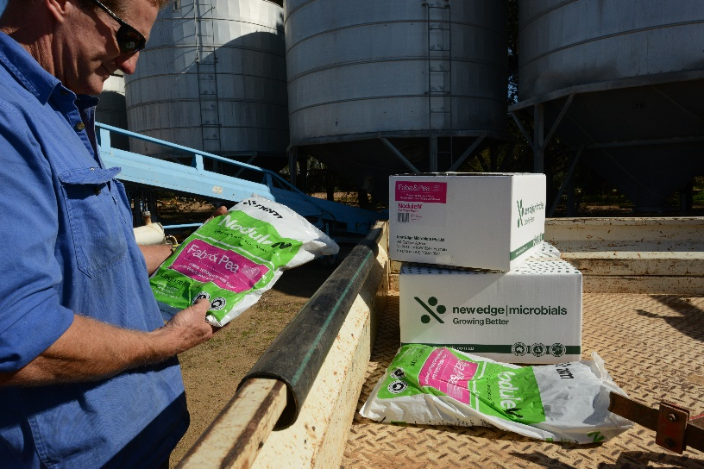
Consider inoculating requirements
Inoculate bare seed or re-inoculate pre-coated seed when:
The particular legume has not been grown in the paddock previously or it has been longer than 4 years.
There are newly introduced advanced strains with increased effectiveness and survival than those used in the paddock in the past.
The pre-inoculated seed has a batch date greater than five weeks prior to the date of intended use.
The presence of acidic (<5.5 pH_{Ca}) or highly alkaline soils in the paddock may limit survival of the rhizobia in the soil.
The paddock is subjected to particularly prolonged hot, dry conditions; or
The legume has specific rhizobial requirements, e.g. check clover cultivars.
®
www.dpi.gov.au
© State of New South Wales through Department of Planning, Industry & Environment 2020. The information contained in this publication is based on knowledge and understanding at the time of writing (September 2020). However, because of advances in knowledge, users are reminded of the need to ensure that the information upon which they rely is up to date and to check the currency of the information with the appropriate officer of the Department of Planning, Industry & Environment or the user’s independent adviser.

Slide 6

Purchase and care of inoculants
Fresh is best when it comes to the purchase and care of biological inoculant products as they contain living rhizobia. The decisions made in selecting the right product, and transporting and handling products appropriately, will optimise the results of legume nodulation and maximise yield potential.
®
Product selection check
Green Ticked for a quality assured product
Correct inoculant host group for each legume
Optimal soil pH for rhizobia strain
Product is within expiry date for peat inoculants
Product is used soon after batch production date for pre-coated seed
www.dpi.gov.au
© State of New South Wales through Department of Planning, Industry & Environment 2020. The information contained in this publication is based on knowledge and understanding at the time of writing (September 2020). However, because of advances in knowledge, users are reminded of the need to ensure that the information upon which they rely is up to date and to check the currency of the information with the appropriate officer of the Department of Planning, Industry & Environment or the user’s independent adviser.

Slide 7
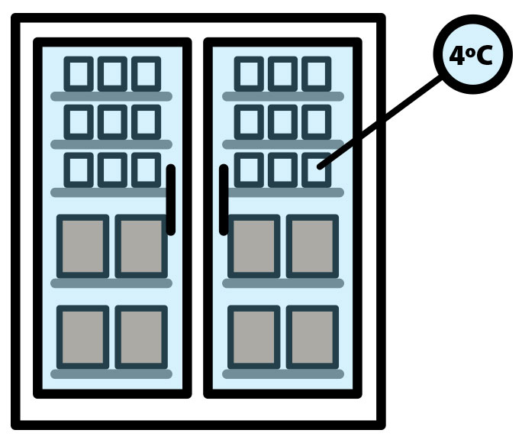

Purchase and care of inoculants
In-store storage check
Peat products are refrigerated at 4ºC
Pre-coated seed is not in direct sunlight
Pre-coated seed is stored below 25ºC
Viable bare seed is used for custom inoculation
®
Transport check
Carry products out of direct sunlight and in a cool esky from store to farm
www.dpi.gov.au
© State of New South Wales through Department of Planning, Industry & Environment 2020. The information contained in this publication is based on knowledge and understanding at the time of writing (September 2020). However, because of advances in knowledge, users are reminded of the need to ensure that the information upon which they rely is up to date and to check the currency of the information with the appropriate officer of the Department of Planning, Industry & Environment or the user’s independent adviser.

Slide 8
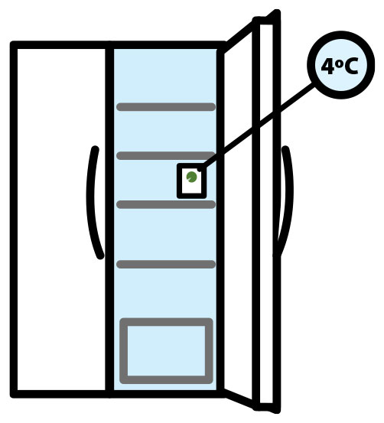
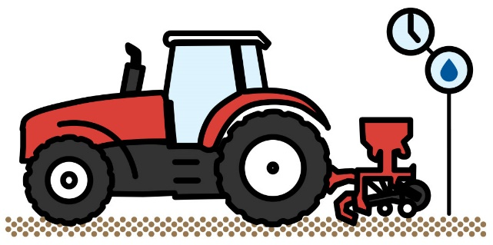
Purchase and care of inoculants
On-farm storage check
Peat products are refrigerated at 4ºC
Pre-coated seed is not in direct sunlight
Pre-coated seed is stored below 25ºC
Custom store inoculated seed is used fresh
®
On-farm use check
Soil status for optimal pH (>5.5_{Ca} ), sulfur, phosphorus and molybdenum
Potable water used in inoculation process
Crushing or cracking seed is avoided
Limit rhizobia/ fungicide exposure time to <5 hrs
Sow into a moist soil, <24hrs for peat & <6hrs for liquid or freeze dried products
www.dpi.gov.au
© State of New South Wales through Department of Planning, Industry & Environment 2020. The information contained in this publication is based on knowledge and understanding at the time of writing (September 2020). However, because of advances in knowledge, users are reminded of the need to ensure that the information upon which they rely is up to date and to check the currency of the information with the appropriate officer of the Department of Planning, Industry & Environment or the user’s independent adviser.

Slide 9

Further information
Jessica Rigg, Research Officer Soil Microbiology
Australian Inoculants Research Group (AIRG), Soils & Water R&D Unit
Department of Regional NSW
Elizabeth Macarthur Agricultural Institute
Woodbridge Rd, Menangle NSW 2568
Private Mail Bag 4008, Narellan NSW 2567
https://www.dpi.nsw.gov.au/inoculants
airg@dpi.nsw.gov.au
www.dpi.gov.au
© State of New South Wales through Department of Planning, Industry & Environment 2020. The information contained in this publication is based on knowledge and understanding at the time of writing (September 2020). However, because of advances in knowledge, users are reminded of the need to ensure that the information upon which they rely is up to date and to check the currency of the information with the appropriate officer of the Department of Planning, Industry & Environment or the user’s independent adviser.

